Slide 1
File Management
Tips for naming and managing files:
Avoid spaces or non-alphanumeric characters, with_the exception_of_underscore; names are case-sensitive
For easier reference, include version numbers or dates
Keep original raw data files in a safe place; don’t save over!!
Include a README.txt file in your “Data” and “Rcode” folders to remind you what different datafiles contain, e.g., especially after being cleaned and manipulated, and/or tasks performed by different R codes
You will forget!! ☹
Notes:
README.txt file is like metadata for your data!

Slide 2
File Management
NOTE: Where you store your data & and affiliated files may depend on:
1. The size of the file
(a 3 KB text file vs 3 MB sound file vs 3 GB database vs 2 TB video file)
1 byte * 1024 = 1 KB * 1024 = 1 MB * 1024 = 1 GB * 1024 = 1 TB
2. The sensitivity of the data
- Are there security issues?
- Consider password protected folders or file-formats that protect personally-identifiable information

Slide 3
File Management
Keeping in mind the “Tree” folder structure
Where on your computer are you storing files for this course?
Where are you storing your R scripts?
Where are you storing data you collect or data you download (e.g., raw data files)?
Where do you intend to store any data you have cleaned & manipulated for a given assignment or project?

Slide 4
File Management
When organizing a collection of files…
Can you come up with a logical grouping mechanism?
By category?
By file type?
By time?

Slide 5
File Management
Example Folder structure
Documents / Fall2025 / courses / BIO456 / Rcode / Labs / Lab1
Documents / Fall2025 / courses / BIO456 / Rcode / Projects / Project1
vs
Documents / Fall2025 / courses / BIO456 / Projects / Rcode / Project1
Documents / Fall2025 / courses / BIO456 / Labs / Rcode / Lab1
vs
Documents / courses / Fall2025 / BIO456 / Labs /Week2 / Rcode
Documents / courses / Fall2025 / BIO456 / Lectures / Week2
time
file type
category

Slide 6
Activity 1: File Management
Can you help your lost & confused classmate organize their files on their computer???
Assignmnent1RawData.csv
InClassEx_1_barplot.jpg
InClassEx_2_scatterplot.jpg
Assignment2_barplot.png
InClassEx_1.R
InClassEx_3.R
Assignment2_linegraph.png
InClassEx_1_cleaneddata.csv
Rcode_Assignment1.R
FinalProjectCleanData1.csv
InClassEx_1_rawdata.csv
Rcode1_Assignment2.R
FinalProjectRawData1.csv
InClassEx_2.R
Rode1_FinalProject.R
FinalProjectRawData2.csv
InClassEx_2_rawdata.csv
Rcode2_Assignment2.R
Name of drive

Slide 7
Activity 1: File Management
Think about how you might organize the files into folders…
Assignmnent1RawData.csv
InClassEx_1_barplot.jpg
InClassEx_2_scatterplot.jpg
Assignment2_barplot.png
InClassEx_1.R
InClassEx_3.R
Assignment2_linegraph.png
InClassEx_1_cleaneddata.csv
Rcode_Assignment1.R
FinalProjectCleanData1.csv
InClassEx_1_rawdata.csv
Rcode1_Assignment2.R
FinalProjectRawData1.csv
InClassEx_2.R
Rode1_FinalProject.R
FinalProjectRawData2.csv
InClassEx_2_rawdata.csv
Rcode2_Assignment2.R
Folder_Name
Folder_Name
Name of drive

Slide 8
What are data? Data types (in statistics)
Categorical
Numerical
Nominal
Ordinal
Continuous
Discrete
Predictor/Independent versus Response/Dependent variables

Slide 9
Working with Data in R Data Types vs. Data Structures
Character
Numeric
Integer
Logical
Complex
Factor
Vector
Matrix
Array
Data frame
List

Slide 10
Working with Data in R Data Types vs. Data Structures
Character | “hello”, “a”, “1” | Letters, numbers, symbols
Numeric | 0.05, 27.3, 154902.0004 | All real numbers
Integer | -731, 1, 5, 206 | All integers (whole numbers)
Logical | TRUE or FALSE | Binary variables
Complex | 1 + 2i | Set of complex numbers
Factor | “High”, “Medium”, “Low” | Categorical variables with levels (fixed)

Slide 11
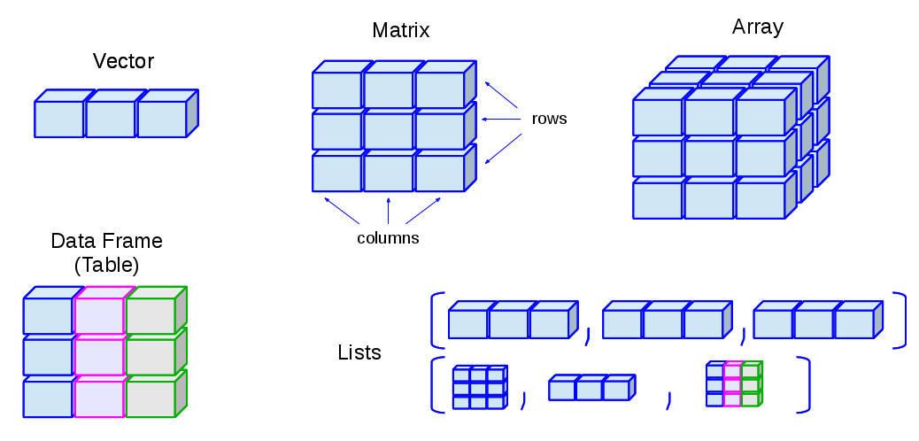
Working with Data in R Data Types vs. Data Structures
Vector
List
Matrix
Data frame
Factor
Note: Colors = data types in this example

Slide 12
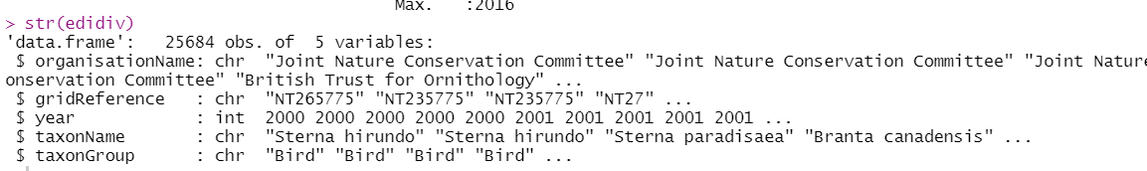
Data Structures can be nested
Example: vectors (of different data types) within a data frame
View data types of each column in the dataset using str()*
*you can also use summary() to achieve the same goal

Slide 13
Data Structures can be nested
Example: vectors (of different data types) within a data frame
Reminder: $ helps you access columns!
e.g.
edidiv$year

Slide 14
My first error in R…
Getting started: Errors reading in your data
Check that the path directory is correct and that the files actually exist in the specified folder; are you telling R which file to read?? Use the list.files() function
Carefully check for typos
Reload any packages (e.g., that might be needed to read in certain types of files such as GIS files)
When in doubt, close and re-open R…

